Slide 1
ĐẠI HỌC ĐÀ NẴNG TRƯỜNG ĐẠI HỌC CÔNG NGHỆ THÔNG TIN VÀ TRUYỀN THÔNG VIỆT – HÀN KHOA KHOA HỌC MÁY TÍNH
ĐỒ ÁN CƠ SỞ 1
TOPIC: BUILDING A CAFE SALES MANAGEMENT APPLICATION
Students perform: TRỊNH THỊ THANH THẢO 23IT252
NGUYỄN QUANG KÍNH 23IT137
Class: 23IT2
Supervisor: ThS VÕ NGỌC ĐẠT
Đà Nẵng, tháng 6 năm 2024

Slide 2
CONTENT
OVERVIEW INTRODUCTION
DESIGN ANALYSIS
EVALUATION AND CONCLUSION
APPENDIX

Slide 3
PART 1
OVERVIEW INTRODUCTION

Slide 4

INTRODUCTION TO THE SUBJECT
Reason for choosing the topic
With the development of information technology, informatics has become the core of management, helping to reduce manual work and optimize performance. We chose the topic “Coffee shop management” to apply the knowledge we have learned to build an effective, convenient and professional management system, helping to solve problems such as counting, billing and statistics in the café.
When expanding the business model, the management of goods must be increasingly strict and more professional because the quantity, type, and rotation between brandches are becoming more and more complicated.

Slide 5
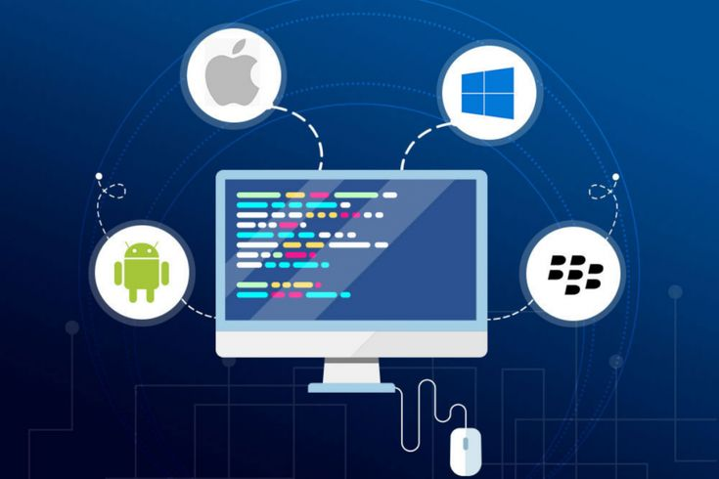
INTRODUCTION TO THE SUBJECT
Describe the topic
App for managing cafes selling different types of drinks and dishes. The shop owner manages income and expenditure and statistics.
Each table has a main waiter, has a code, table status, and dish, and is processed by the staff on the app
Managers can view statistical reports on sales and revenue of all types by day, month or year

Slide 6

INTRODUCTION TO THE SUBJECT
Application building platform
Support the data entry management department, store employee information, tables, dish types, and employee accounts.
Quickly look up the status of tables, support payments, and store invoices
Clear statistics, login function with correct user rights
Supports viewing files and editing files when using the app

Slide 7
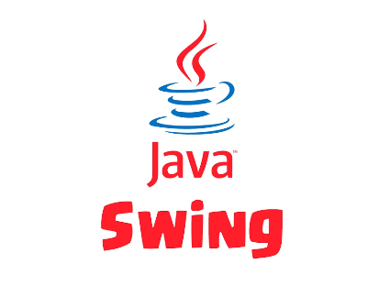

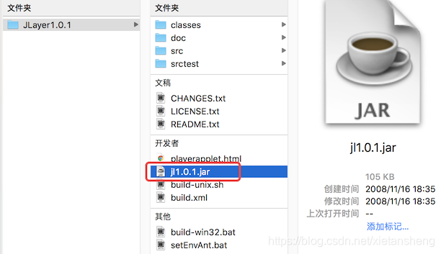
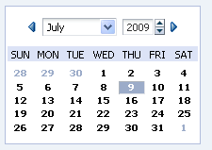
INTRODUCTION TO THE SUBJECT
Technology used
Java: is the primary language used to develop application logic and data processing.
JavaSwing: a Graphical User Interface (GUI) toolkit that includes GUI components
Jl1.0.1.jar: Music library
Datechooser.jar provides a UI component for selecting dates.

Slide 8
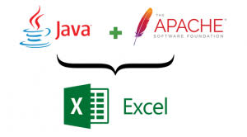
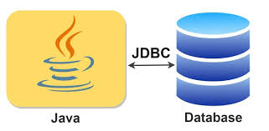

INTRODUCTION TO THE SUBJECT
Technology used
MySQL/SQL Server : database
Mysql-connector-j-8.3.0.jar/sqljdbc42.jar: Library connects to SQL Server/ MySQL
Poi-3.17.jar, poi-ooxml-3.17.jar, poi-ooxml-schemas-3.17.jar, xmlbeans-2.6.0.jar, commons-collections4-4.4.jar :file excel library

Slide 9

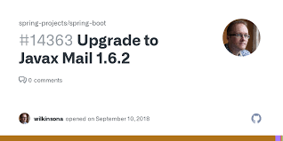

INTRODUCTION TO THE SUBJECT
Công nghệ sử dụng
Javax.activation.jar, Javax.mail-1.6.2.jar : gmail library
Neatbeans: IDE for Java language.
Xampp : Supports localhost installation for the device.

Slide 10

INTRODUCTION TO THE SUBJECT
Target
Build a convenient, quality, and friendly program that provides optimal user support
Helps managers save time and makes it easier for employees to sell
Helps students understand and grasp knowledge, gain more practical knowledge

Slide 11
PART 2
DESIGN ANALYSIS

Slide 12
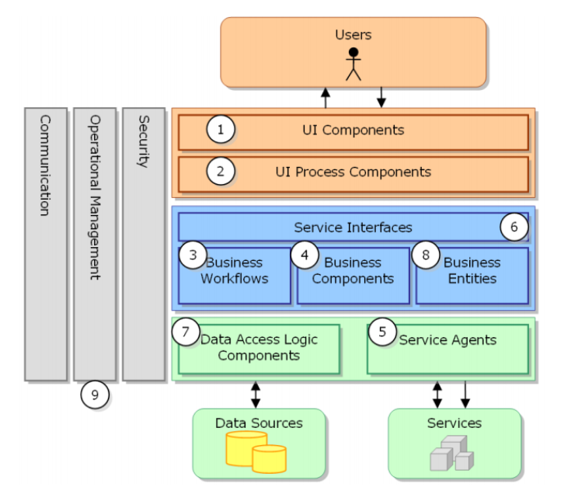
DESIGN ANALYSIS
Usage model
Use a three-layer model (DAO, BUS, GUI)
Functions of 3 layers:
- GUI : show interface
- BUS: Receive requests from GUI and access data
- DAO: access with database
Benefits of using the model:
- Divide into easy to manage layer
- Easily divide the workload
- Bug fixing support becomes easier, making it easier to develop and reuse code

Slide 13
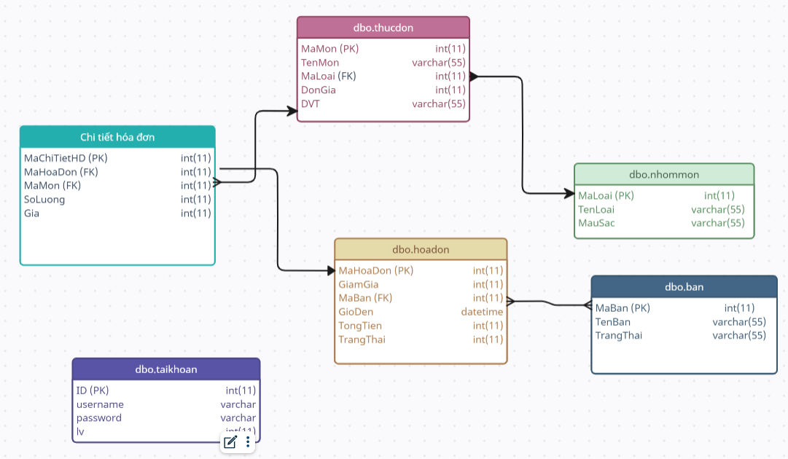
DESIGN ANALYSIS
Mô hình cơ sở dữ liệu

Slide 14
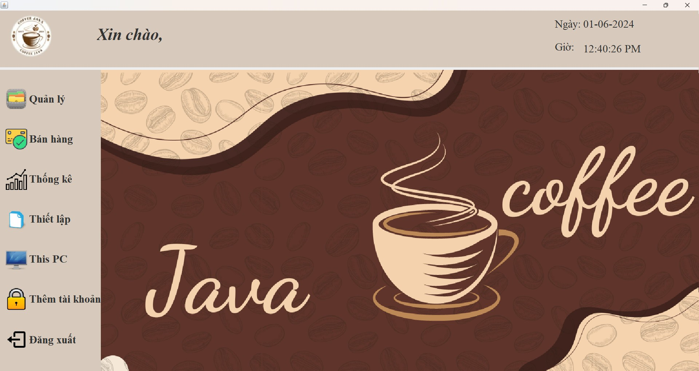
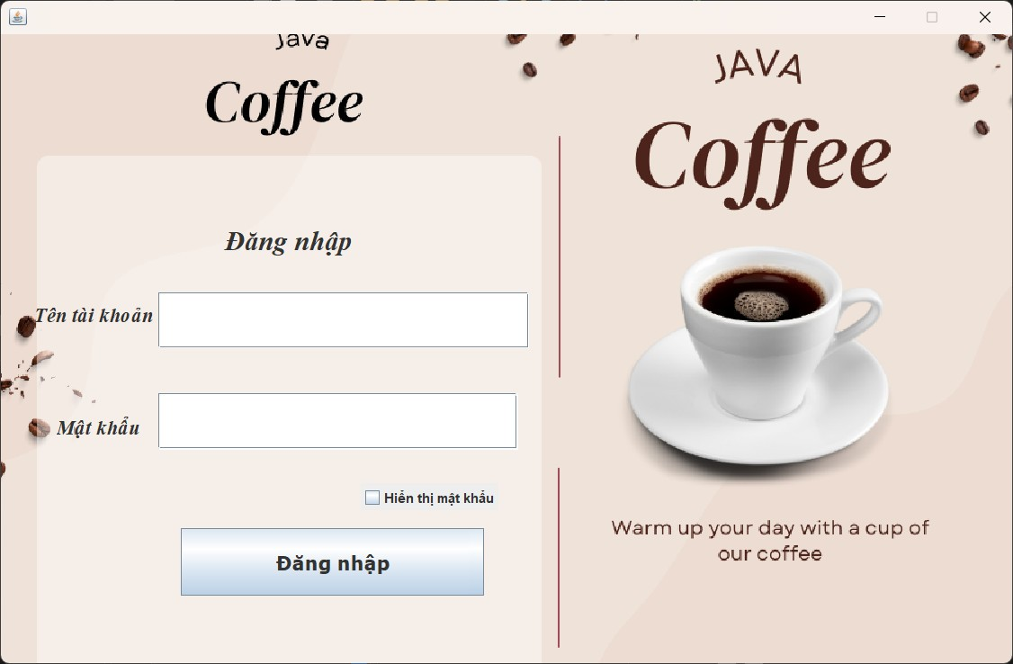
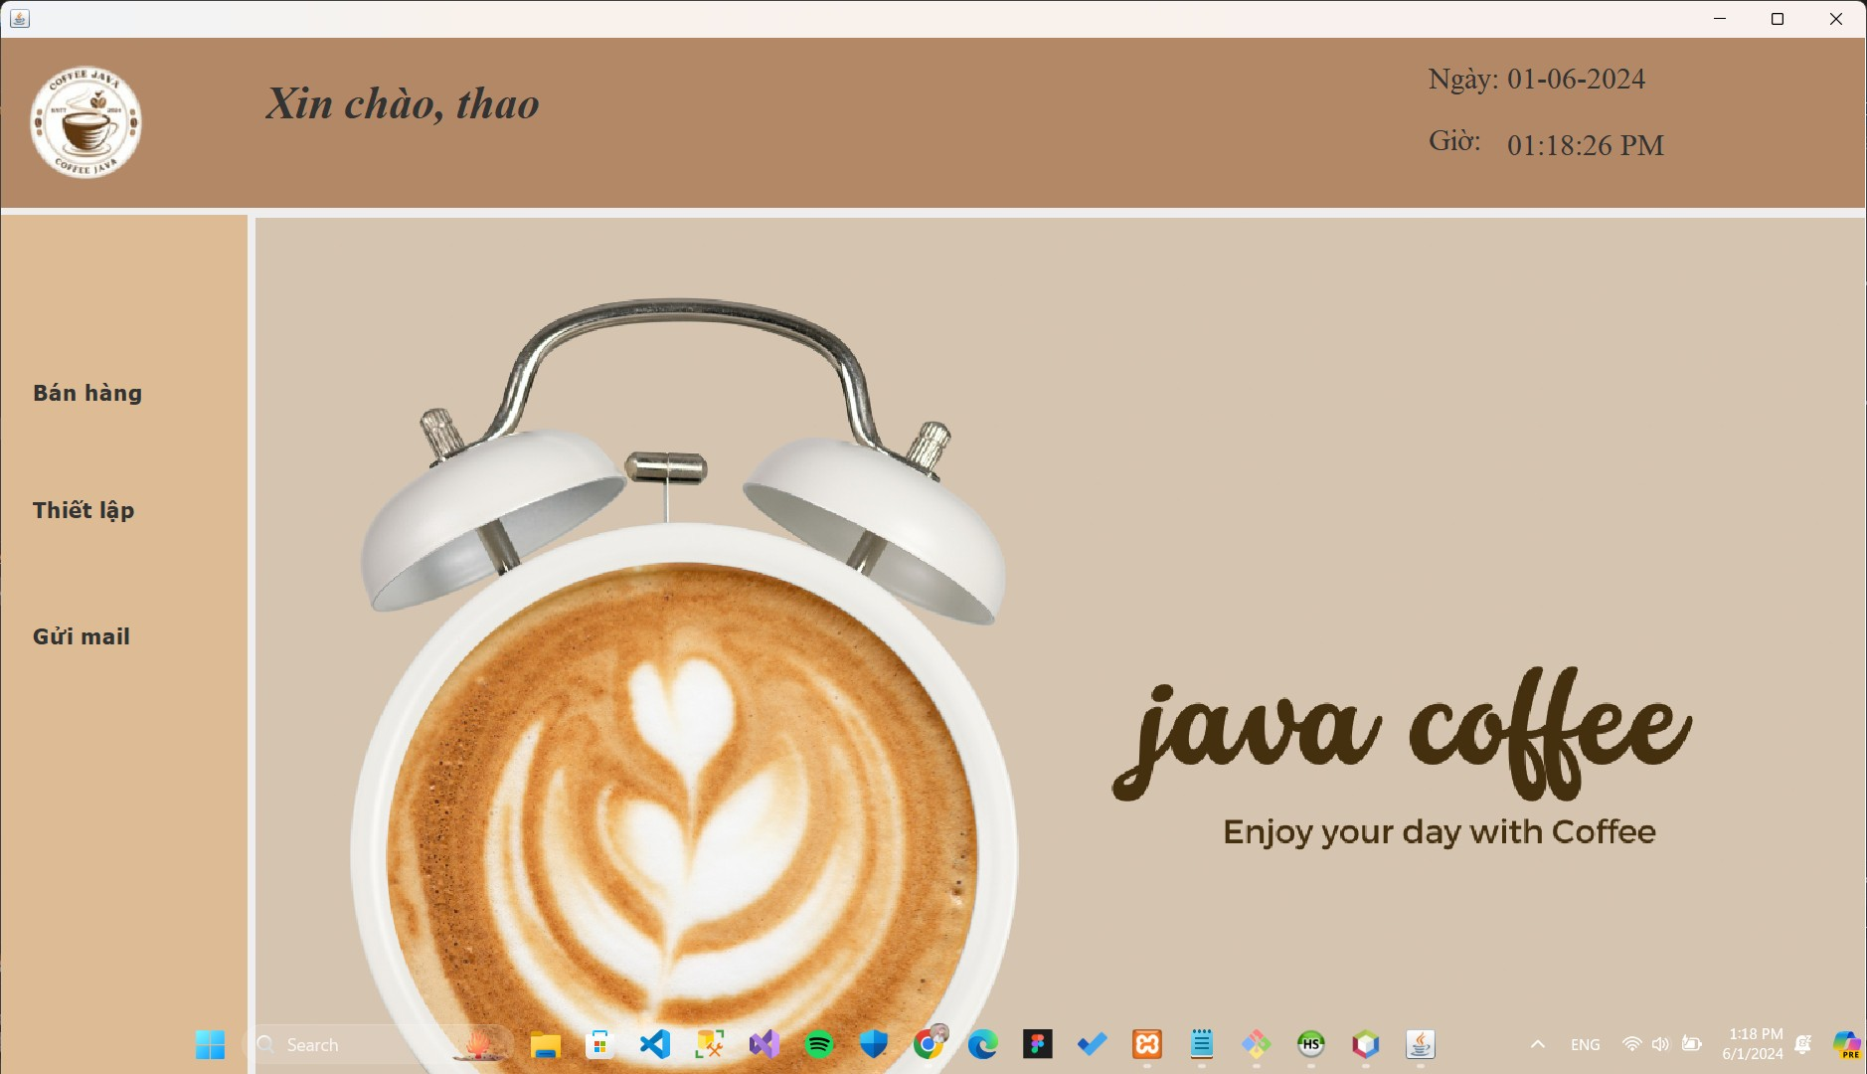
DESIGN ANALYSIS
Main functions of the system
Management’s home page
Login to the app
LOGIN , APP HOMEPAGE
Staff home page

Slide 15
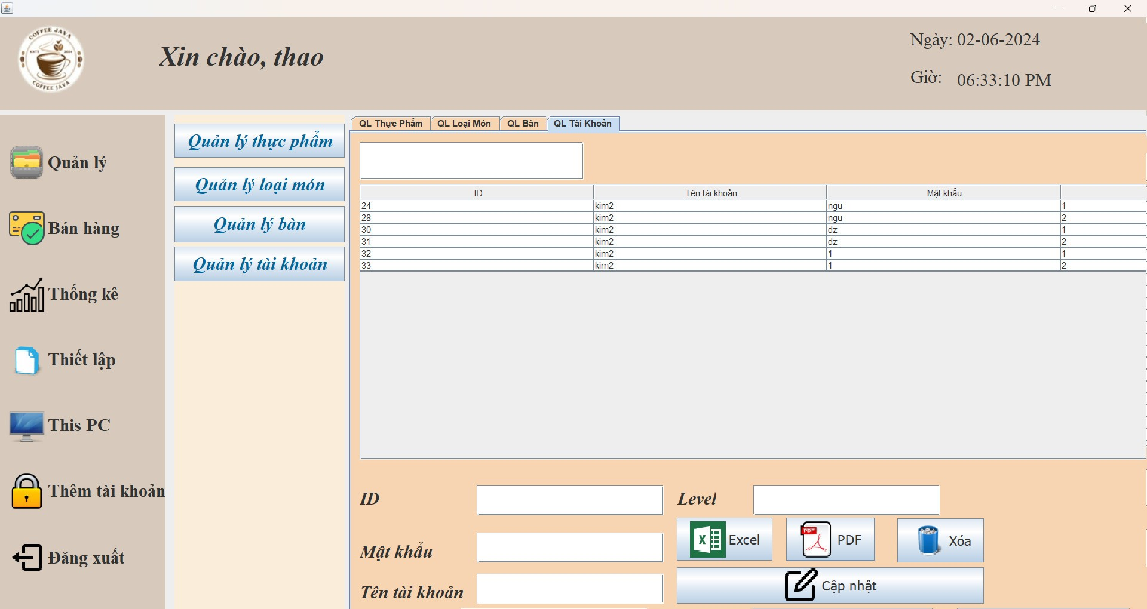
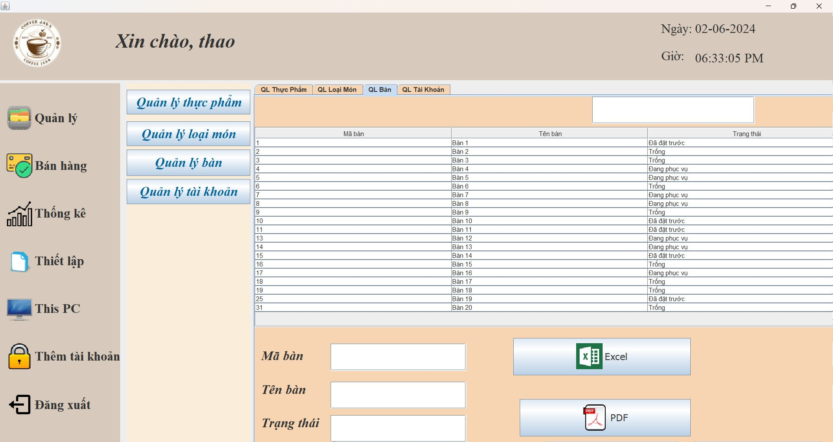
DESIGN ANALYSIS
Main functions of the system
ADD, EDIT, DELETE, SEARCH, BUILD FILE
Managers track food, dish types, tables and accounts.

Slide 16
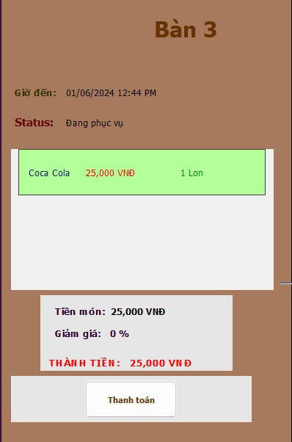
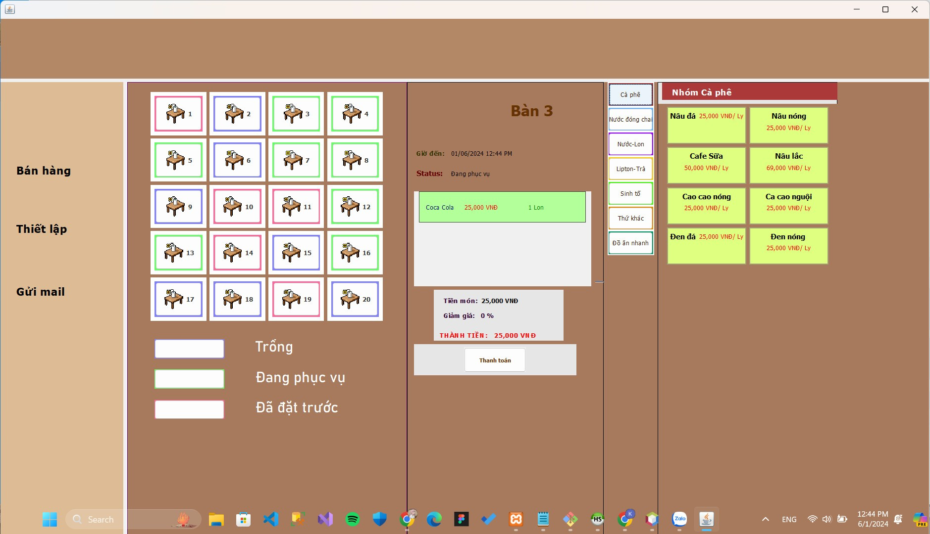
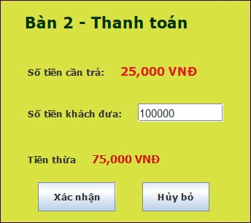
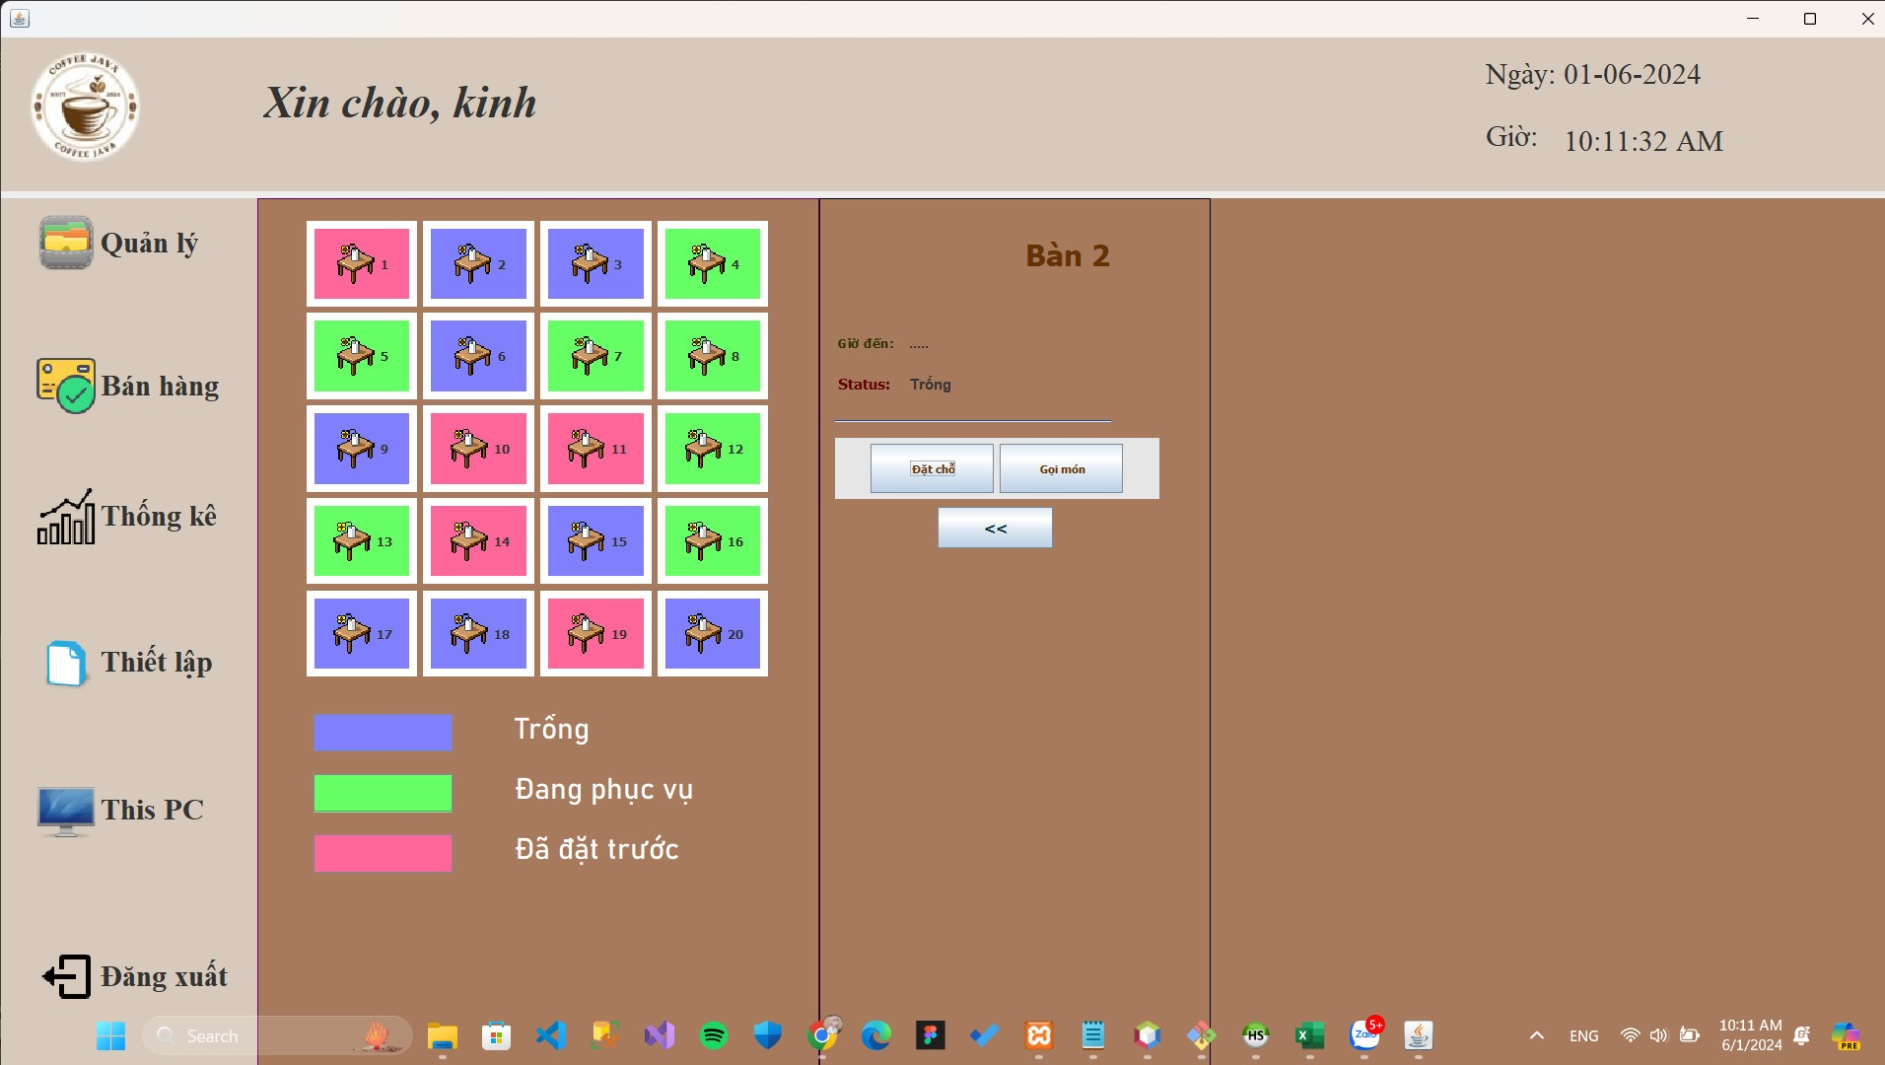
DESIGN ANALYSIS
Main functions of the system
SELL
The seller will view the table status to book/order
Display menu to order
Support payment and display invoices for customers
Table status
Show item type
Bill
Pay

Slide 17
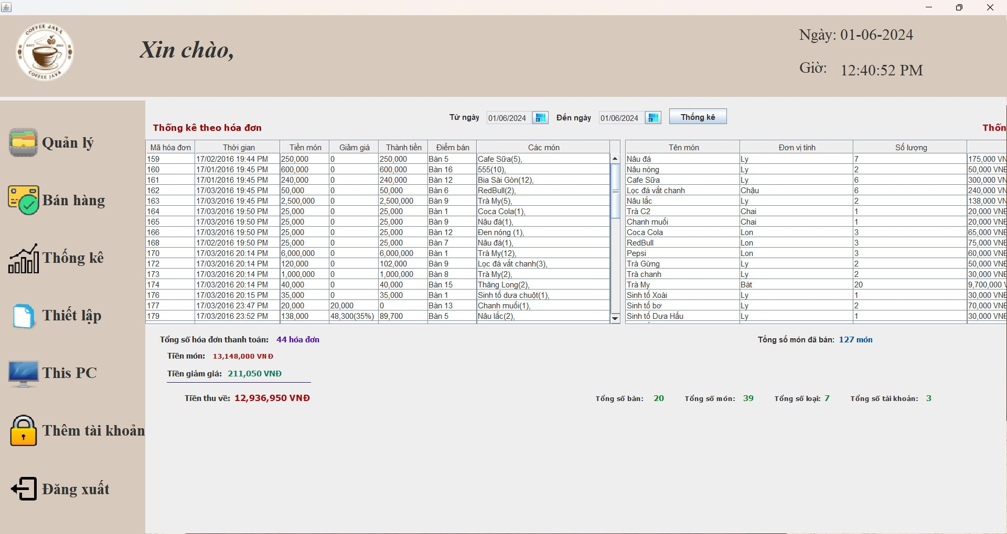
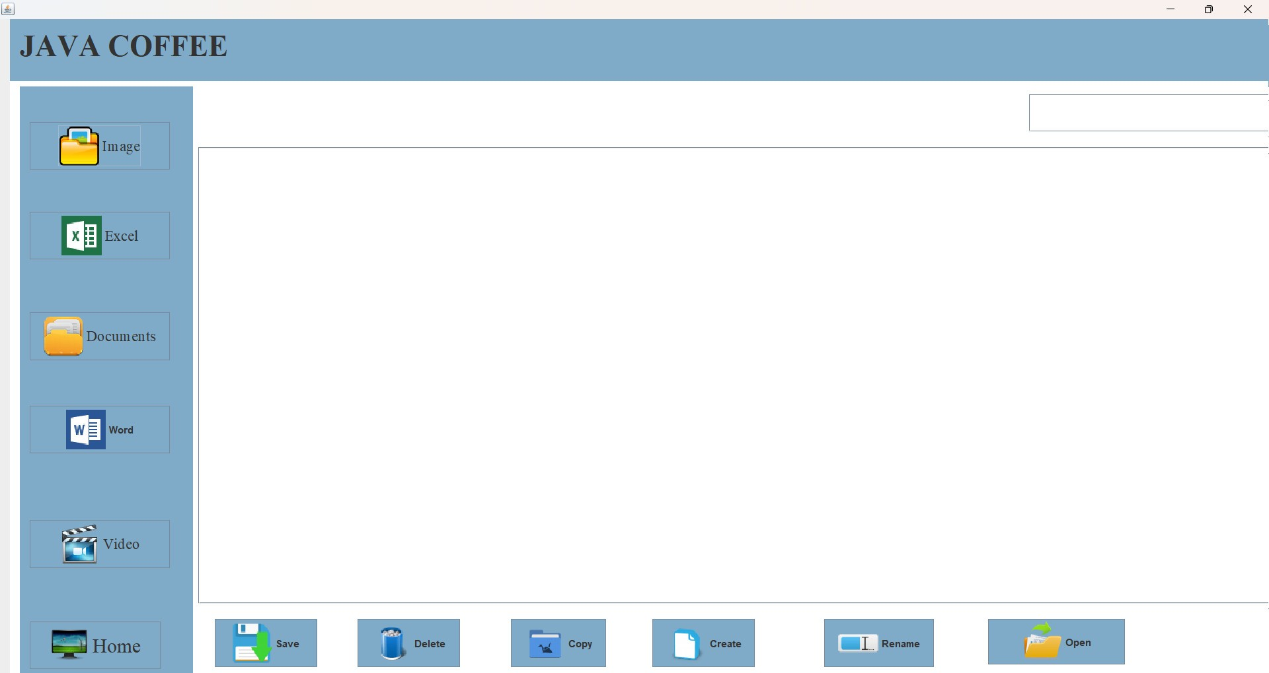
DESIGN ANALYSIS
Statistical
Managers can make statistics by month and year
Manage money, discounts, money collected
Statistics on the number of items sold
This PC
Save/edit/manipulate all statistical file activities, dish lists, employees. When using the app

Slide 18
PART 3
EVALUATION AND CONCLUSION

Slide 19
EVALUATION AND CONCLUSION
Evaluate
Advantage:
User-friendly interface, easy to use.
Access the database easily, without affecting other databases
Take advantage of the three-tier architecture for maximum software development
Has high development potential.
Disadvantage:
The software is still quite sketchy and doesn’t have the functions we want to achieve.
The process is quite slow
There are many technical errors we have not yet discovered

Slide 20

EVALUATION AND CONCLUSION
Development directions and Solutions
Complete the functions that the team wants to accomplish
Improve software quality
Expand the scope of use of the software, not just limited to coffee management software

Slide 21
CONCLUDE
Result
After a period of implementation, the program ran and achieved the following results:
Meet the basic requirements of the café management system
Optimized three layer architecture
Brings convenience to users
The software has the potential to be upgraded, becoming a full-fledgrd management application
Limit
There are still many unfinished functions.
The most disadvantages are due to technical limittations (code, database) and knowledge

Slide 22

APPENDIX
Tài liệu tham khảo
Codelearn – 3 layer
Database Management System 3rd Edition - Râmkrishnan
VIBLO – file excel in java use API Apache POI
Link github
https://github.com/Trinhthanhthaoo/QLQuanCafe

Slide 23
THANK YOU
FOR WATCHING!

